Slide 1
Lecture 10: Overview of class
May 29, 2018

Slide 2
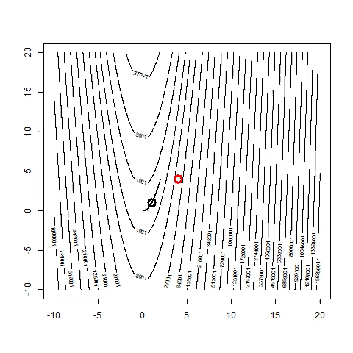
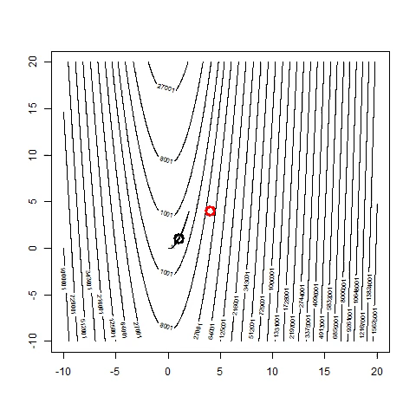
Week 1 – Generalized linear models

Slide 3
Week 1 – Generalized linear models
Important messages
Likelihood is probability of the data given parameters
Maximum likelihood estimates are “consistent”
No claim about bias → Need to use simulation testing!
Can estimate imprecision using inverse-hessian of likelihood around MLE
Explore joint imprecision → Simulate from multivariate normal
General linear models have three components
Linear predictor
Link function
Distribution for data

Slide 4
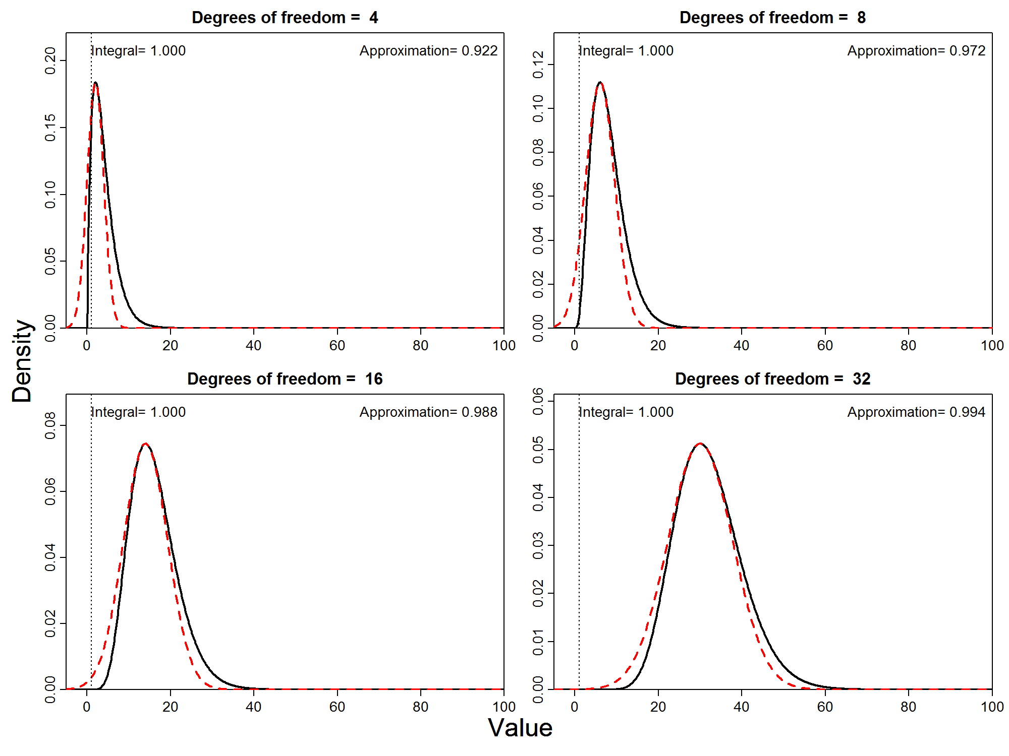
Week 2 – Generalized linear mixed models

Slide 5
Week 2 – Generalized linear mixed models
Important messages
Marginal likelihood is integral across probability of data and probability of random effects
Weighted average across unobserved variables
Laplace approximation is fast for to get marginal likelihood
Approximates log-likelihood of random effects with a multivariate normal distribution
Generalized linear mixed model has four components
Linear predictor
Link function
Distribution for random effects
Distribution for data

Slide 6
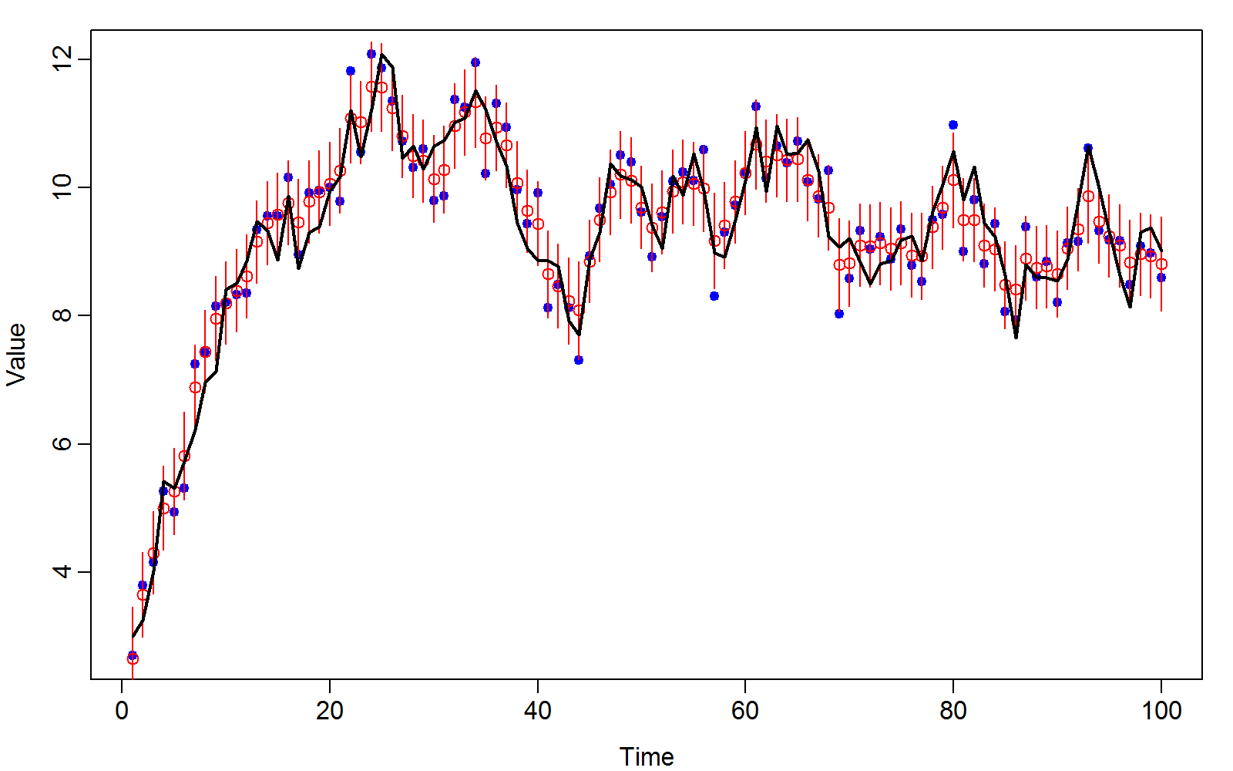
Week 3 – Time series models

Slide 7
Week 3 – Time series models
Important messages
Kalman filter is useful
Good to interpolate or forecast time series
Gompertz model approximates simple population dynamics
Involves first-order autoregressive model
1st order Taylor series approximation to dynamics

Slide 8
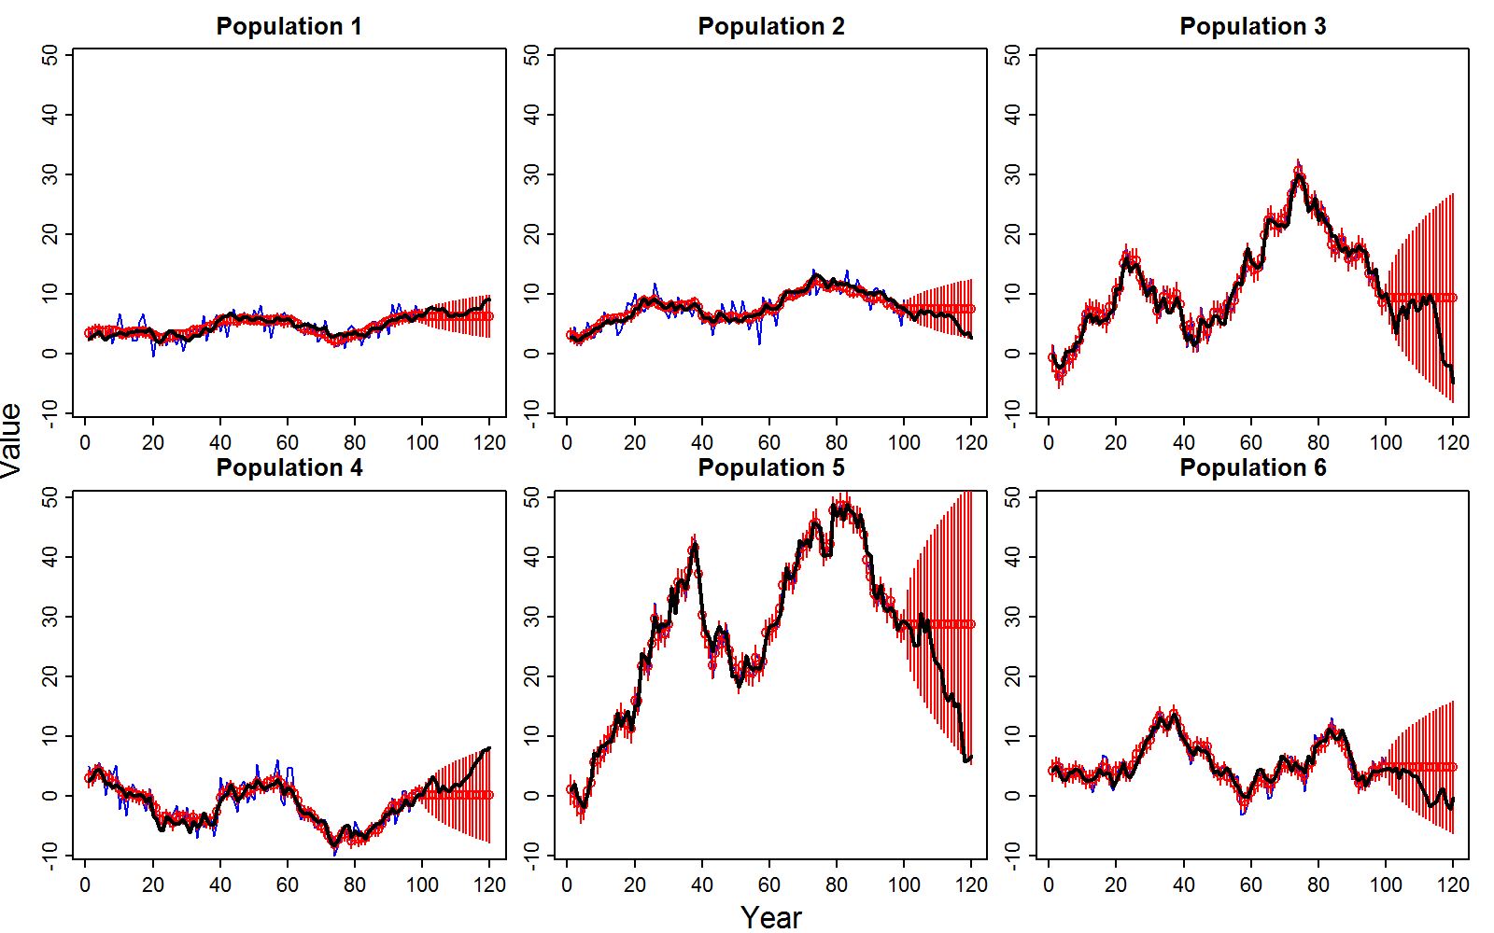
Week 4 – Theory of time-series models

Slide 9
Week 4 – Theory of time-series models
Important messages
Can interpret covariance matrix several ways
Cholesky: Useful to simulate multivariate data
Eigen-decomposition: Useful to think about number of components
Multivariate Kalman filters are simple and useful
Generate univariate Kalman filters, then multiply by Cholesky
Useful to predict covariance and extrapolate time series

Slide 10
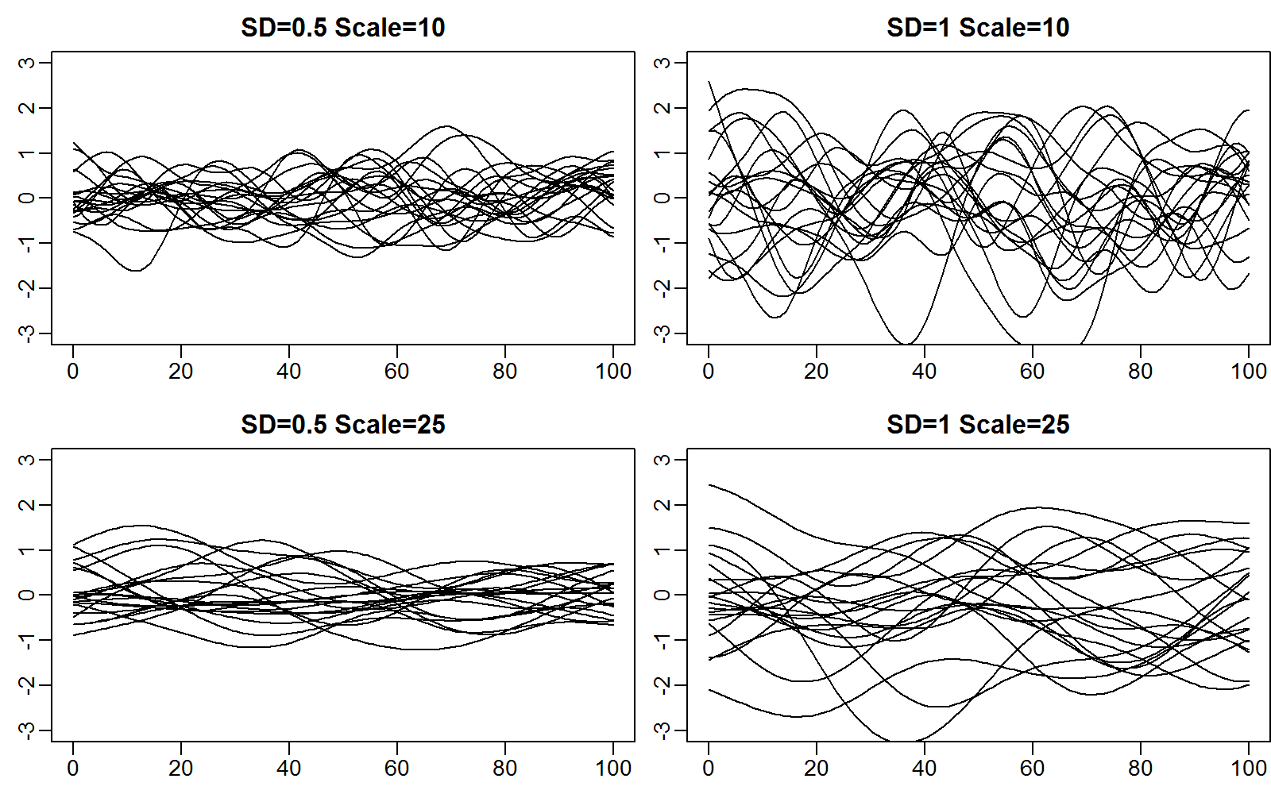
Week 5 – 1D spatial models

Slide 11
Week 5 – 1D spatial models
Important messages
Multivariate normal distribution requires inverse-covariance (“precision”) matrix
Precision matrix is sparse for 1st order autoregressive process with equal spacing
Easy to compute 1st order AR process with uneven spacing by sweeping downstream

Slide 12
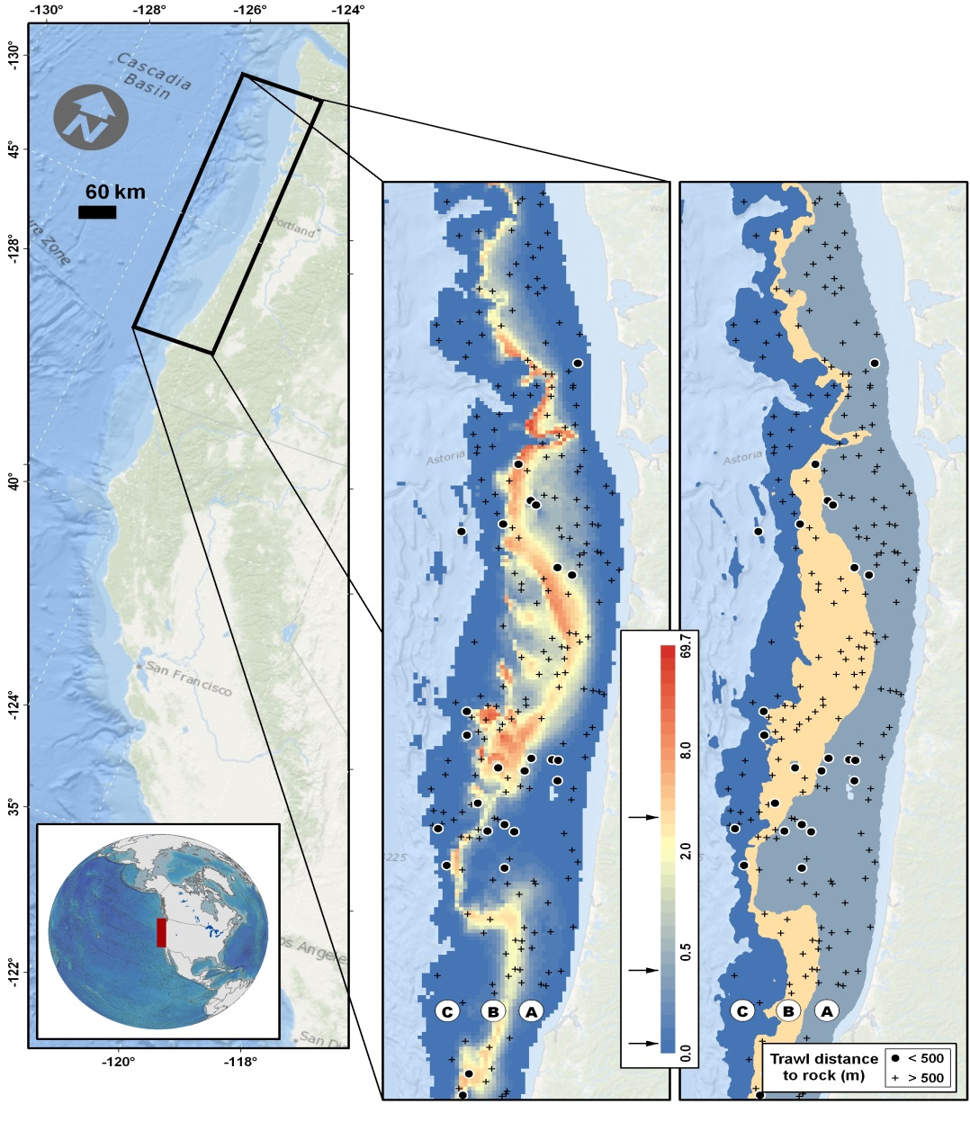
Week 6 – 2D spatial models

Slide 13
Week 6 – 2D spatial models
Important messages
Can replace kriging with mixed-effect estimation
Simultaneously estimate variance and decorrelation range, plus 2D surface
Precision matrix for a 2D autoregressive process is formed from Kroenecker product of 1D precision matrices
Kroenecker product preserves sparseness
Given random locations in 2D, can use a “SPDE approximation” with a Matern correlation function

Slide 14
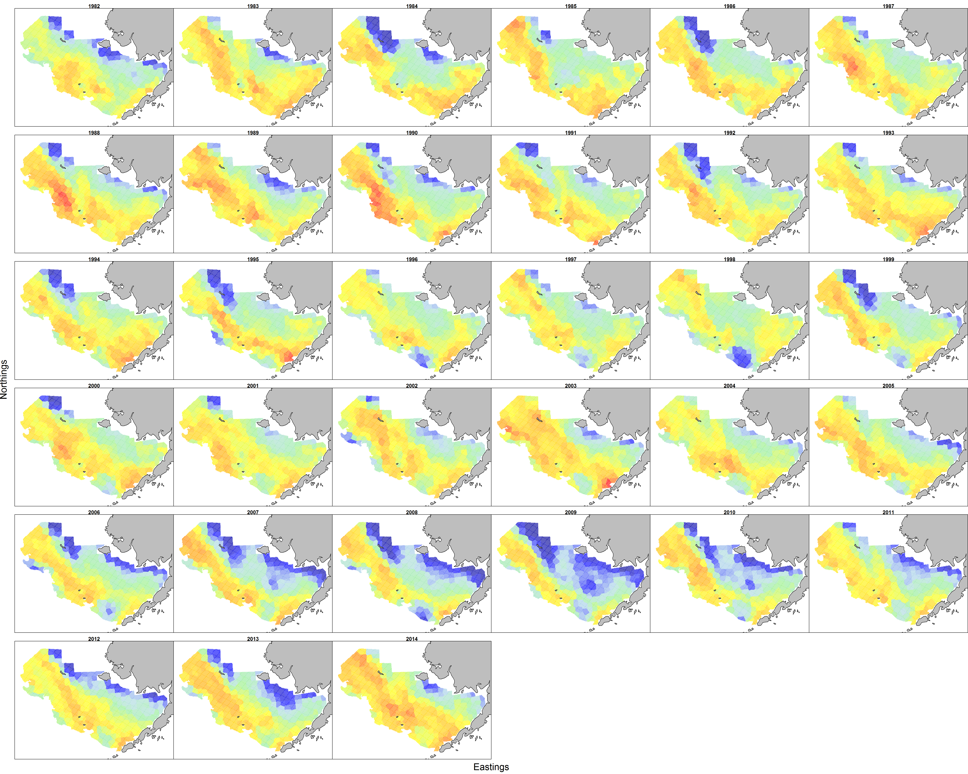
Week 7 – spatio-temporal models
Alaska pollock in the Eastern Bering Sea

Slide 15
Week 7 – spatio-temporal models
Important messages
Precision matrix for random effects over 2D space and time are formed from Kroenecker product of 2D space and 1D time
Using a 1st order AR process for time, this is the “spatial Gompertz model” for density-dependent population dynamics
Can instead specify 2D distribution for random effects in each year, and sweep downstream through time
Easier for specifying density-dependent functions for dynamics
Generate “conditional Gaussian” models

Slide 16
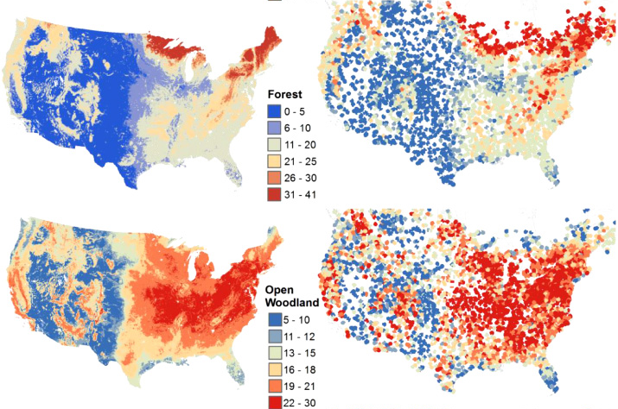
Week 8 – multivariate models

Slide 17
Week 8 – multivariate models
Important messages
Many settings have multiple response variables
Density for multiple species
Correlated environmental measurements
Can model correlations in response using Kroenecker product with full-rank covariance among response variables
Often easier to use “factor analysis” approach
Equivalent to first columns of Cholesky decomposition for covariance among response variables

Slide 18
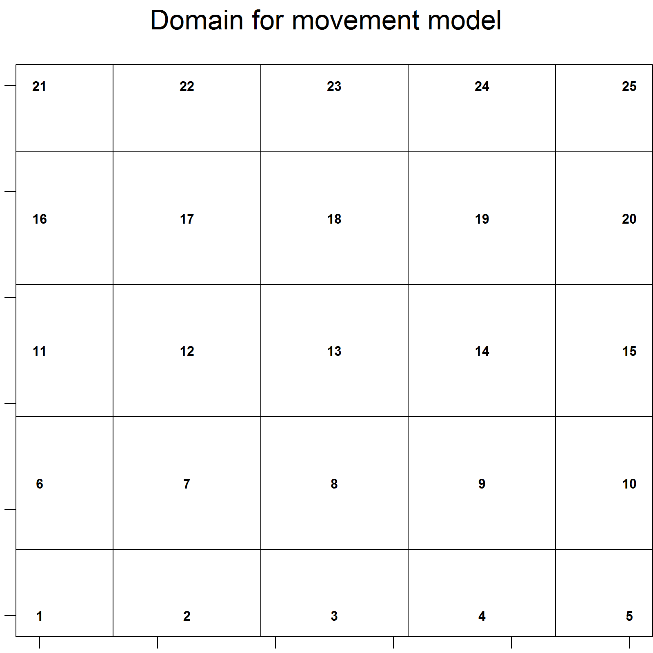
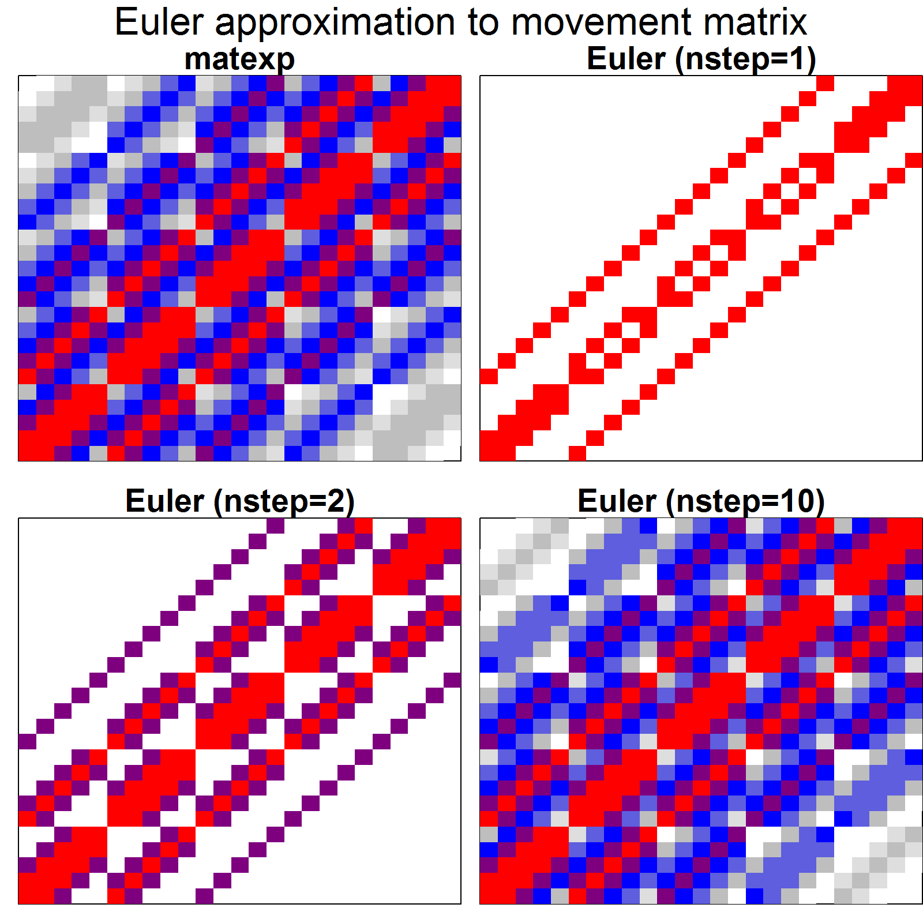
Week 9 – streams and movement

Slide 19
Week 9 – streams and movement
Important messages
Can incorporate localized movement
Specify matrix for instantaneous movement
Use matrix exponential operator to calculate annual movement
Easy to combine with spatio-temporal models
Stream network distances can be modeled
Easy to specify 1st order autoregressive process (exponential correlation function)
Can be combined with estimates of “detectability”

